Slide 1
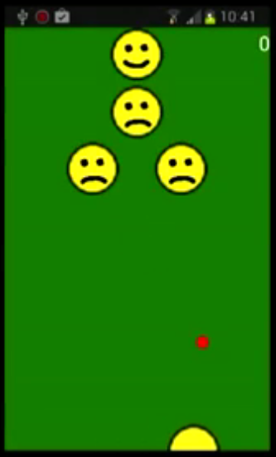
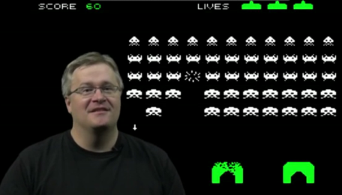
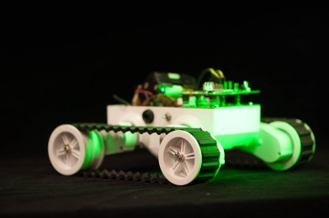
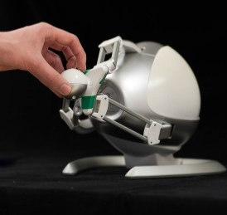
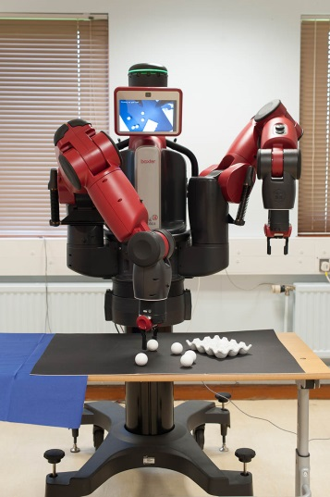
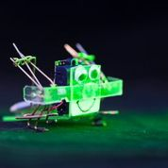
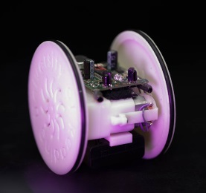
DeveLOP FOR SUCCESS in MassIVE OPEN ONLINE CoURSES
Dr Karsten Lundqvist and Prof Richard Mitchell
Learn from our experiences in Begin Programming and Begin Robotics.
Novel content and approaches – impact on ‘normal’ courses
Potential for the future

Slide 2
About Karsten
Computer Scientist
Loves games
Research interest
Use of technology and Artificial Intelligence to improve teaching and learning
Social networking
Gamification of education
Use of games in education
Tutoring
Feedback provision
Online courses

Slide 3
KarsteN’s MOOC
Now in its 6th run …
Over 140,000 participants
Aim – to teach programming and inspire to learn more…

Slide 4
About RIChard
Cyberneticist
Came to Reading to learn Cybernetics …
Interests
Cybernetics ..
So control theory, artificial intelligence, robots, Gaia Theory
Educational aspects of Cybernetics
How can technology help - interaction

Slide 5
Richard’s mooc
Just finished second run
Over 9,500 in June/July … nearly 8,000 in Sept/Oct
Aim – excite / inform people about robotics …

Slide 6
MOOC
Massive(ly)
Open
Online
Course
Delivered to large numbers
1000 +
Not tens
Anyone can participate
No cost for the basic course
(Often) an open license
Delivered via the internet
Other materials may be available
Has a start and an end
Clear learning objectives

Slide 7
activity
Who has participated in a MOOC?
What subject?
Who was the provider?
Was it completed?
Was it good?

Slide 8
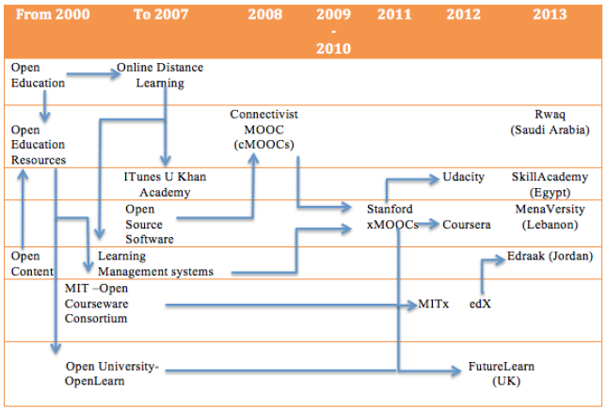
Timeline
R. S. Adham, and K. Ø. Lundqvist, “MOOCS as a Method of Distance Education in the Arab World; A Review Paper”, The European Journal of Open, Distance and E-Learning (EURODL), 2015

Slide 9
Pedagogical Underpinnings
cMOOCs
xMOOCs

Slide 10
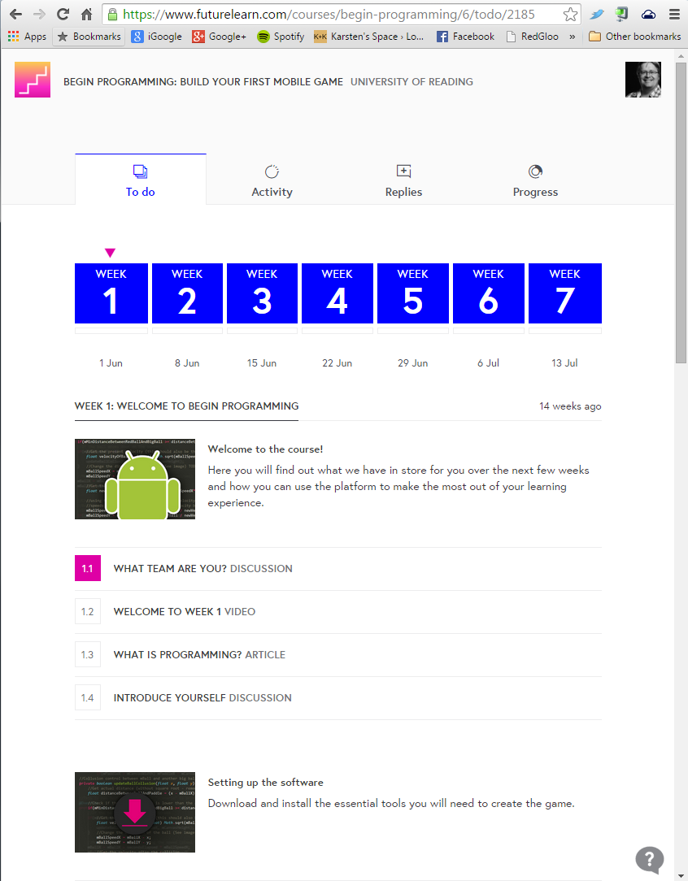
Anatomy of a mooc

Slide 11
continued

Slide 12
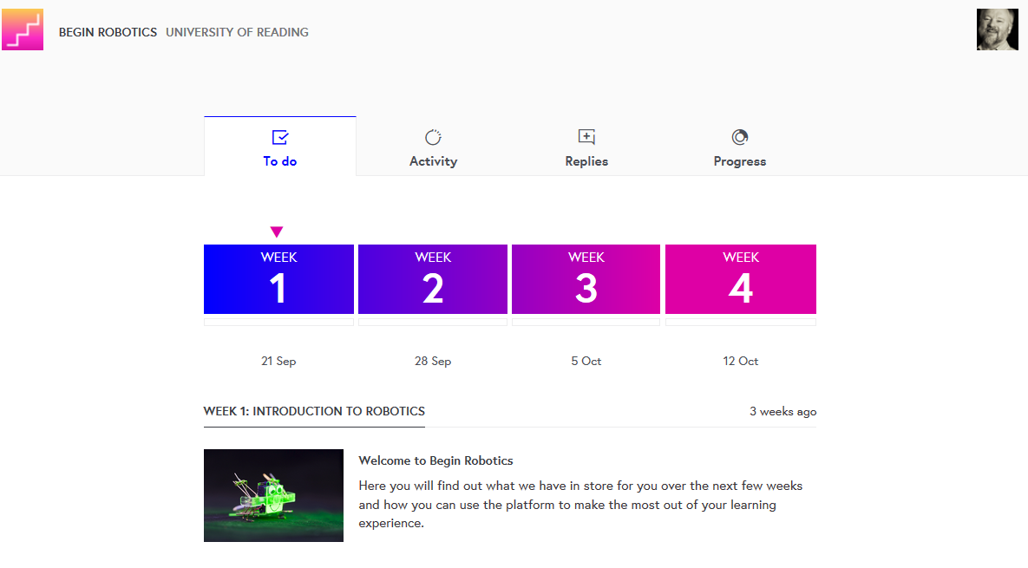
And for robotics

Slide 13
Why moocs
Why would Universities invest in these?
They are free, but there is a cost to make
Average ~£ 30,000
Running costs
Support
Technology
Some MOOCs show how poor teaching can be at University level…

Slide 14
Why moocs – 5 R’s …
Reputation
Who knows about MIT’s open courses?
Outreach!
Karsten’s work has been on national TV
and has been recognised in India!
Recruitment
Many universities use TV commercials, let’s do a cost analysis…
~10% of new students in our School indicate that “Begin Programming” influenced their choice positively.
This has completely covered the costs - this is unusual!
Used in Open Days

Slide 15
Why moocs – 5 R’s …
Renew
Repurpose existing teaching material into a MOOC format improves it
140.000 participants cannot be wrong
University of Edinburgh
Reuse
It makes reuse of material easier. We use MOOC material in
2nd year Java module coursework
1st year Feedback Lectures for RJM
Research
A lot of data!
Most of my research is now connected to MOOCs

Slide 16
Creating moocs

Slide 17
Creating moocs
Planning
is
crucial

Slide 18
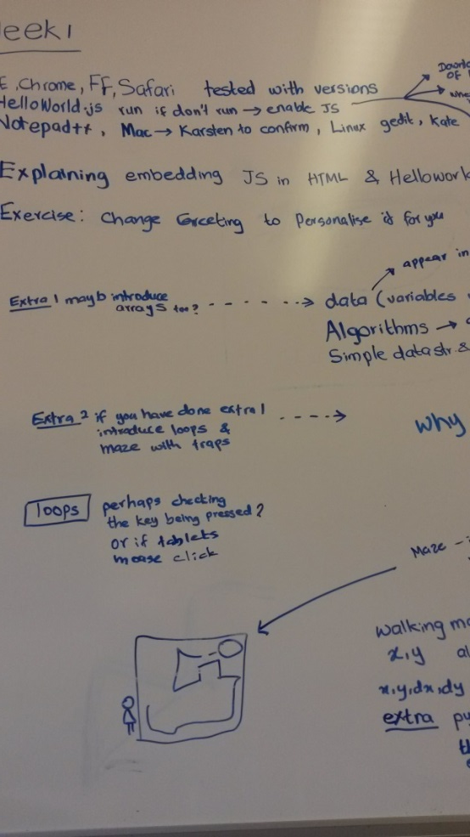
PLANNING MOOCS

Slide 19
Planning moocs
Review your idea - Not just your content!
You might need to change the aim of the MOOC!
Or, you might need to change the aim of your existing content!
Evaluate the underpinning pedagogical philosophy and theory
Can the content be effective without a change?
Could it be even more effective with a change?
I have found it useful to think pedagogically
'Pedagogy is the driver, technology is the accelerator' - Michael Fullan

Slide 20
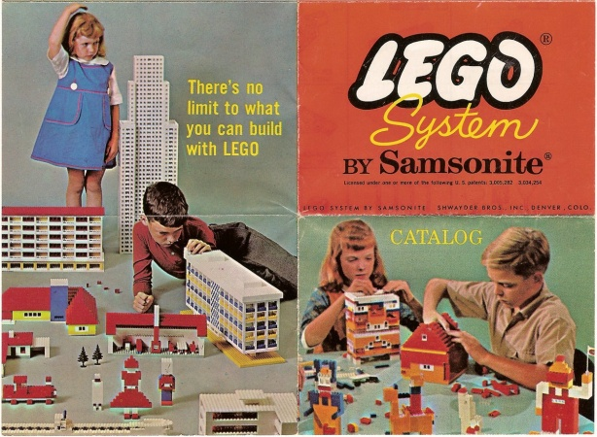
Constructivism (Papert)
Create knowledge from experience / experiments
Make tangible objects to learn (LEGO Mindstorms)
Teaching is important, but learning is much more important

Slide 21
Making engaging material
Learner-centred
Facilitate learner-learner integration and collaboration so that they will learn from one another and expand their knowledge base together (Diaz and Bontenbal 2001)
The goal of learning communities is for students to work together and expand their knowledge base collaboratively (Anderson, 2004; Vygotsky, 1978).
Cognitive presence: study of a particular content
Social presence: supportive environment.
The absence of social presence leads to an inability to express disagreements, share viewpoints, explore differences, and accept support and confirmation from peers and teacher

Slide 22
Engaging elearning material
Quality content (can be low-cost)
Video – Camtasia, Camstudio
Images - Camera, Screenshots, GIMP/Paint .NET
Text
Use website that support communities
Be supportive in the community
Friendly
Allow mistakes
Show your own mistakes
Be part of the community, don’t be The Community

Slide 23
Engage the audience
Create experiences instead of instruction
Facilitate meeting points
Open debate. Allow difference
“How are you getting on?”
“Share your experience!”
“Are you feeling adventurous?”
Ask questions, suggest exercises, excite imagination
“Can you do X?”
“How would you do X?”
“What would you like to do instead of X?”

Slide 24
Case Study - Begin robotics
Great to follow Karsten … learn from experiences
Attended few presentations on MOOCs
Had clear aims – to recruit students
Build on visits to schools, etc ..
Inform and excite
Provide practical examples – but supplying ERIC robot impractical
Achieve by
Short videos …
Interesting articles which provoke interaction
Quizzes
Exercises to do – but how?

Slide 25
exercises
Course is about robots – but not programming
Exercises should be doable on PCs, tablets and phones
Wanted to avoid setting up software, excessive downloads
Solution – HTML5 and javascript
Need a modern browser (supporting canvas), javascript enabled
Issues –
I had to (finish to) learn javascript
FutureLearn had to learn/approve …
So, much time spent developing until standard ok … worth it

Slide 26
Filming
3 days were spent filming
Robots – moving round lab, interacting
Lovely video of ERIC reacting to lights .. Blue Danube waltz
Control and Measurement of Rover Robot
Baxter robot
Colleagues / Student filmed talking about
Baxter, Haptics, Psychology and Haptics, BMI research
One day spent filming me talking …
Learnt – don’t do first video first …
Then a number of Camtasia screencasts, using PPT and Web pages

Slide 27
Structure of course
Week 1 – introduction to robotics, the course and exercises
Videos, articles, timeline for history
Week 2 – anatomy of a robot
Sensors, Actuators, ‘Brain’ and power supplies ..
Week 3 – feedback for control and interaction
Controlling Speed, Position, Temperature .. Including Daisyworld
Interaction with Baxter robot, use of Haptics, Research
Week 4 – feedback for robot-robot interaction and learning
Braitenberg vehicles, trial and error learning, student projects
Each week has 5 quizzes and 2 web page exercises

Slide 28
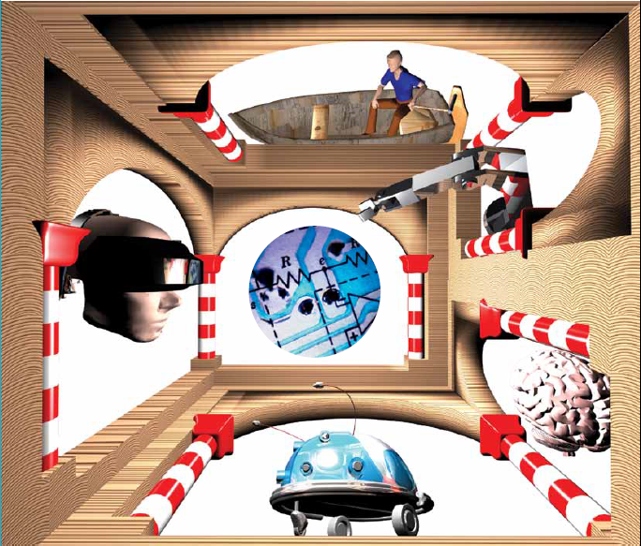
Introducing robotics
A different perspective …
Feedback for
control,
learning, interaction

Slide 29
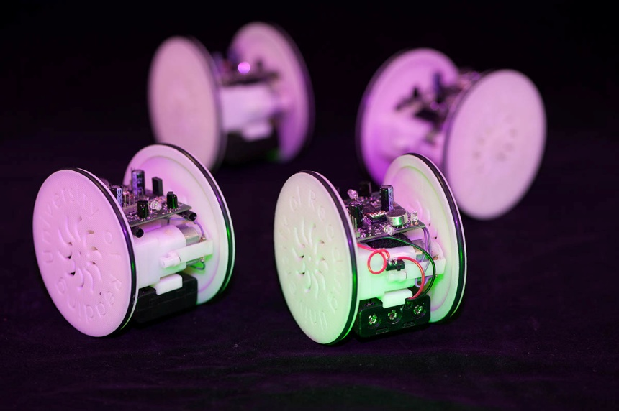
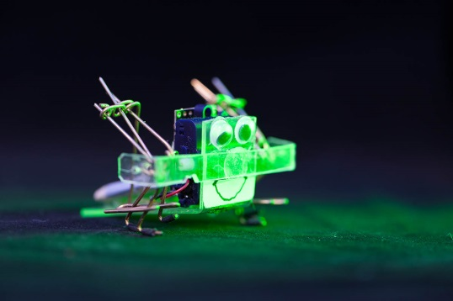
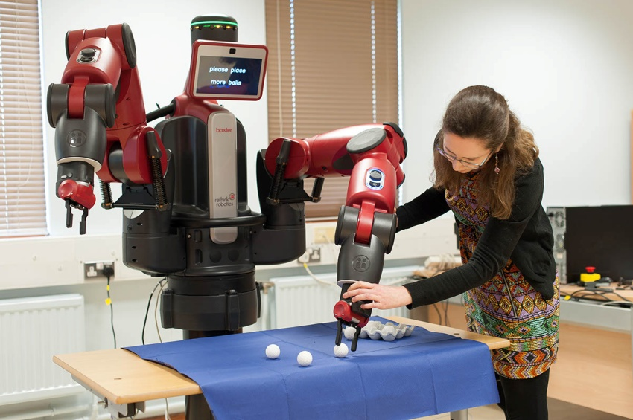
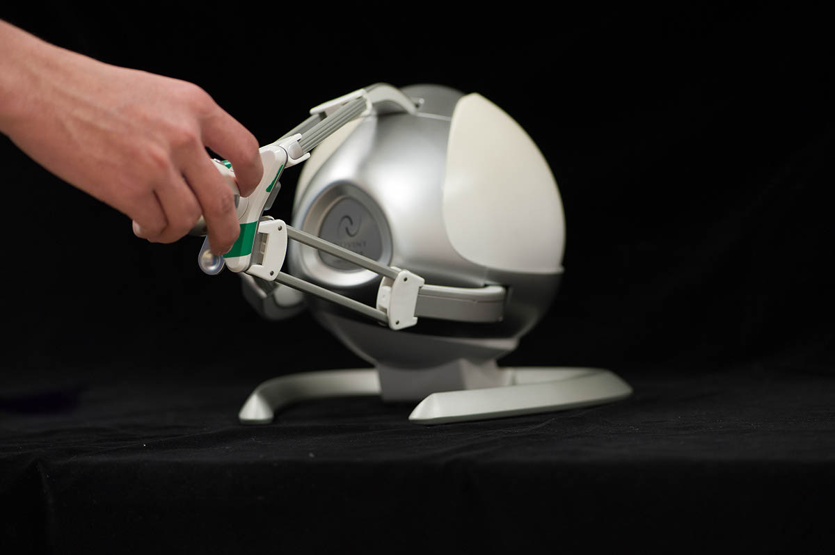
Meet the reading robots

Slide 30
Web pages for explaining

Slide 31
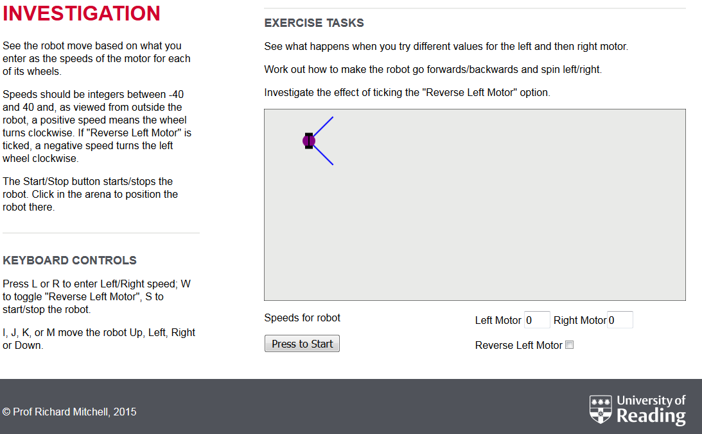
First exercise

Slide 32
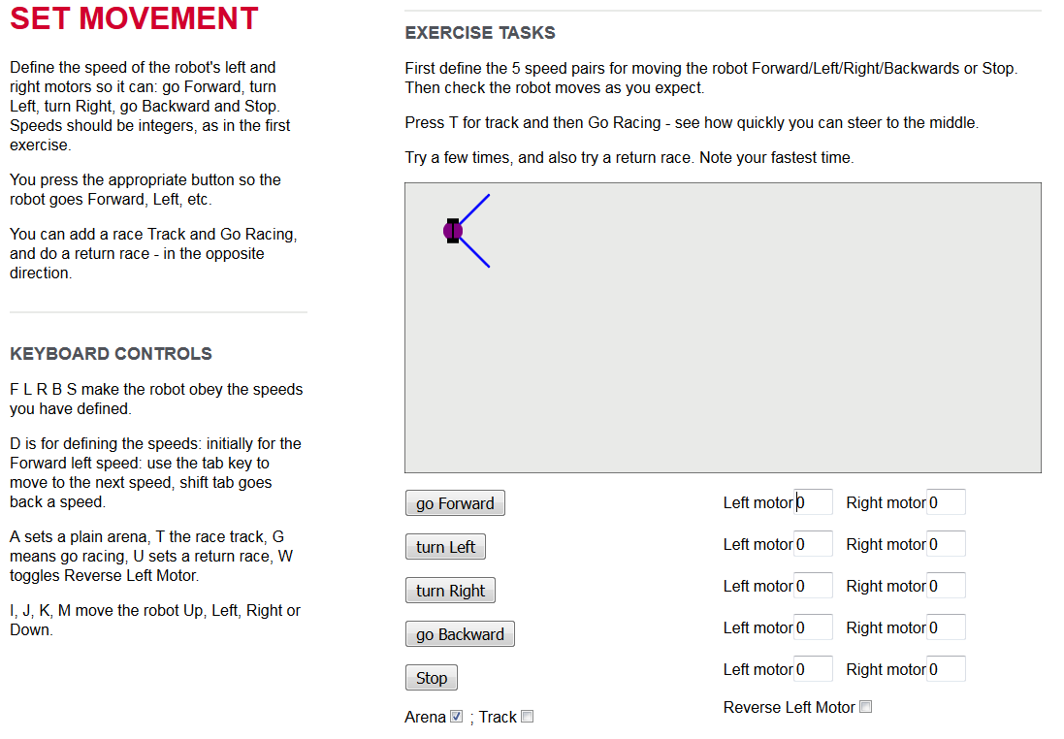
Second exercise

Slide 33
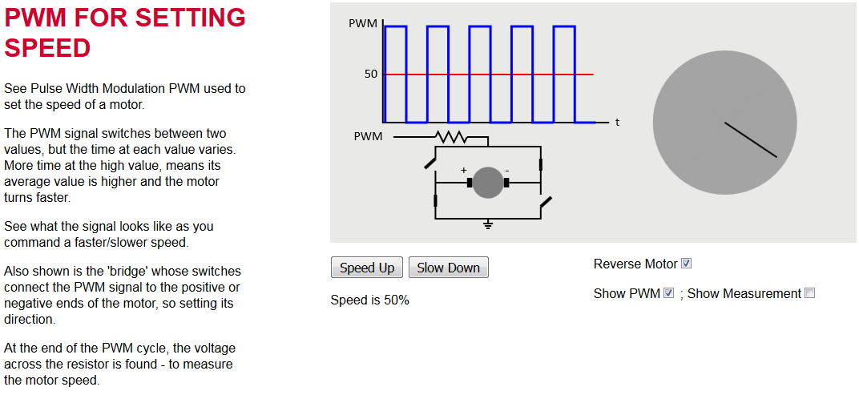
Explaining pwm

Slide 34
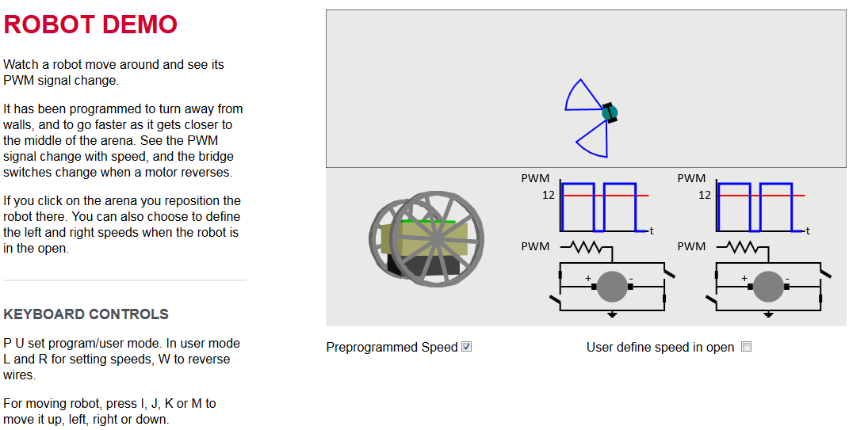
Participant suggestion

Slide 35
Even some maths
Error, E
Friction/Hills
Input, I
v
Output, O
Control
Robot
Explain simple feedback control
Proportional controller : v = C * E
Do arithmetic to show that O does not equal I !
But human controller increase/decrease speed
So integral control : hence P + I control

Slide 36
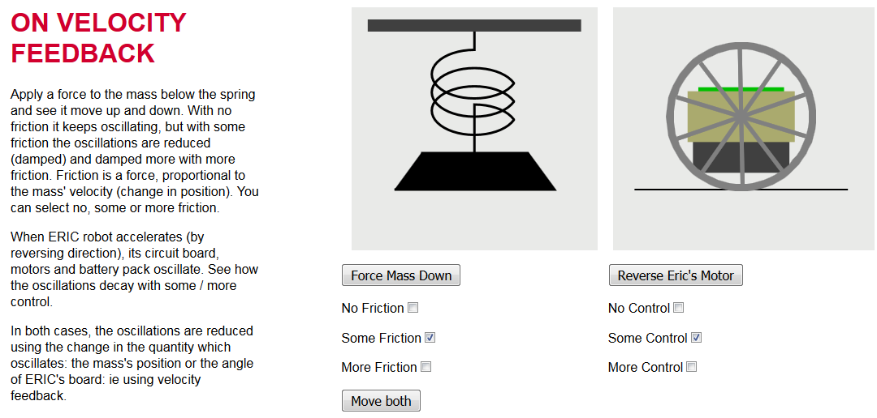
Explaining Rocking eric …

Slide 37
reaction
Few grumbles … ‘SF effects in videos’ … cant download
Some wanted more on ERIC, programming, even maths
But enthusiastic participants –
Posing questions
Answering others’ questions
Commenting
Web pages were a hit
School teachers wanted access for Key Stage 3 / 4
Very few tweaks to second run …
3D ERIC simulation,
Added Line following to exercise for wall avoiding …

Slide 38
Quote – from futurelearn
“The simulations Dr. Mitchell produced for the course brought the topic to life for learners and enabled them to understand & experience robotic principles in a far more engaging way than would otherwise be possible. Encouraging learners to experiment and discuss with others is core to FutureLearn's approach to learning, and it was great to see a course adopt this so thoroughly and to such success. Most importantly, it let students have fun learning. This enjoyment was evident in hundreds of comments across the different exercises: "Is it just me or was that fun??? :-)"

Slide 39
From participant
“Thank you for a truly excellent course that exceeded my expectations. By removing all the barriers to education that are still present in many online courses you allowed one to relax and concentrate on the learning. It made for a much more pleasant learning environment that encouraged exploration and experimentation. The use of simulations put this course head and shoulders above the competition. A free course is not exactly free when hundreds of dollars of parts and test equipment are required for participation. Also the on line simulations just worked, there was no time wasted in the building, testing, and troubleshooting of units prior to attempting the actual learning scenarios. Making the quizzes actual knowledge checks rather than the typical memorization and recall of factoids, eliminated the cringe factor associated with tests. In short, this was a really superior course that facilitated learning. Traditional schools and other online institutions should take note. Well done!”

Slide 40
conclusion
MOOCs have been hard work – but worthwhile
Begin Programming has attracted students.
Begin Robotics has attracted visitors … could help recruit
Comments from participants have been useful and gratifying
These two MOOCs are tasters
Follow on , paid for, courses are feasible
For Programming
For Robot Hardware / Robot Programming

Slide 41
Information
Robots behaving badly
https://www.futurelearn.com/courses/begin-robotics/steps/31304
Robot Exercises at
https://www.reading.ac.uk/UnivRead/vr/OpenOnlineCourses/Files/Simulation2/BeginRoboticsSimulationindex2.pdf
Or follow link from
http://www.personal.reading.ac.uk/~shsmchlr/
Contact
E-mail: k.o.lundqvist@reading.ac.uk
E-mail: r.j.mitchell@reading.ac.uk

